Slide 1
Password Strength Game

Slide 2

Title: Password Strength Game
Subtitle: Final Presentation
Name: Foo Fang Woei
Date: March 2026

Slide 3
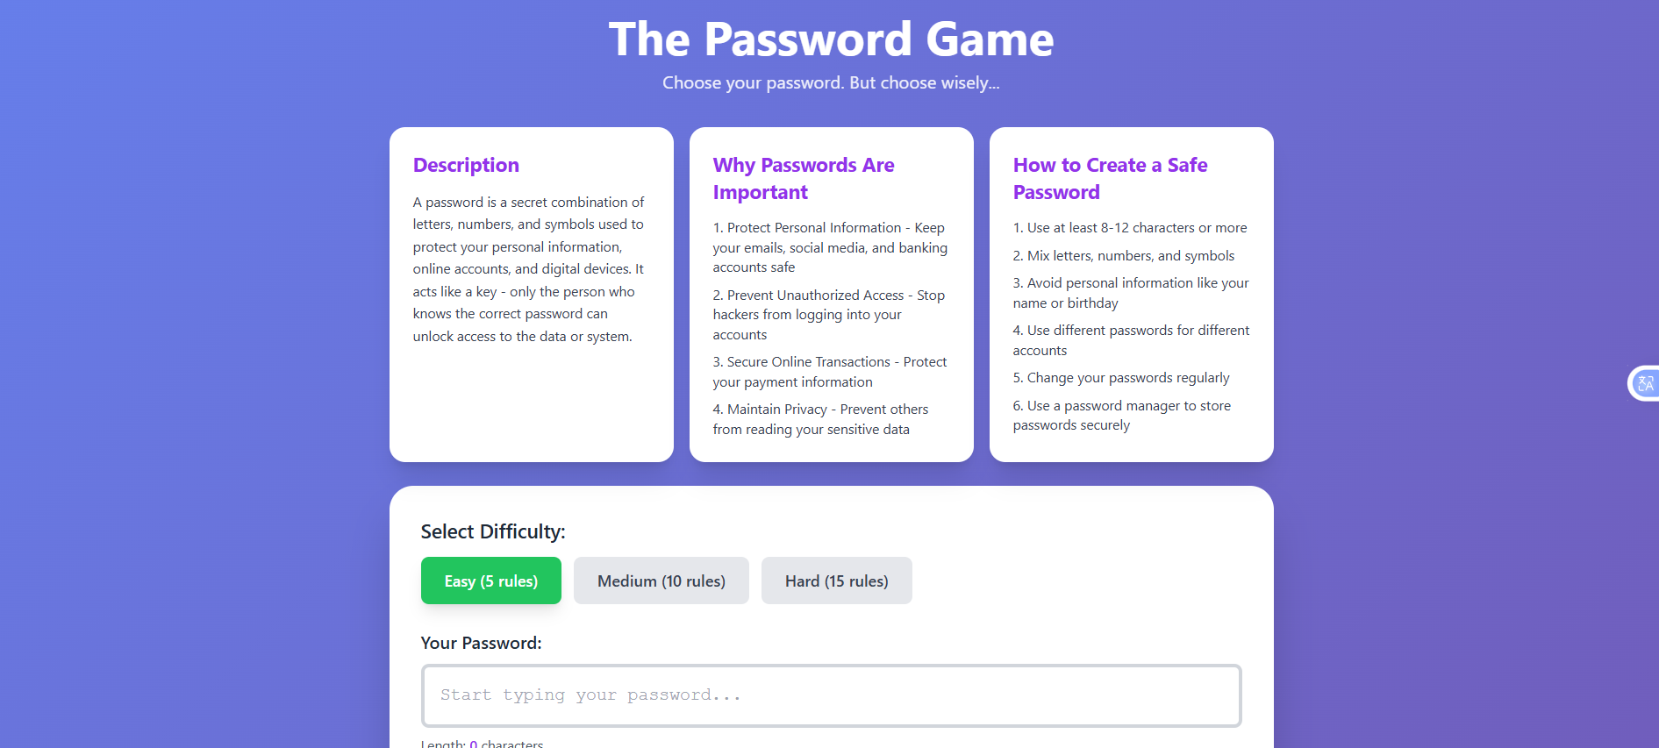
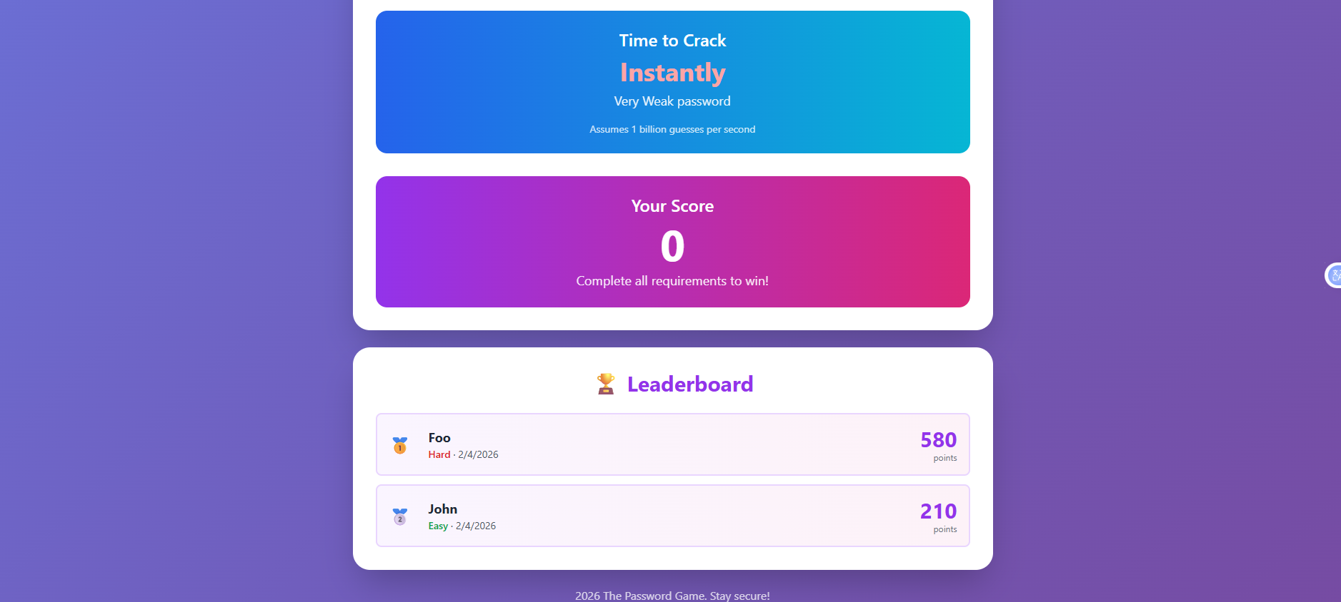
Introduction
What the game is
It is a browser-based game using HTML, CSS, JavaScript
Three difficulty levels: Easy, Medium, Hard
Teaches password security through gameplay
Has leaderboard and crack-time estimator (NEW — not in Sem 1)

Slide 4
Challenges Faced & Problem
Problem 1 - Setting clear password strength levels
Defining clear criteria for what makes a password Easy, Medium, or Hard was a key design challenge
Problem 2 - Traditional advice is boring and ignored
Guidelines like "use 8 characters" are forgettable
— users skip them
Problem 3 - Users don't know what makes a strong password
Most people use weak passwords like '123456' because they don't understand what makes a password strong
Problem 4 - No interactive way to learn
There is no fun, engaging tool that teaches password strength through practice

Slide 5
Objectives
Educate users through interactive gameplay
Three difficulty levels to scaffold learning
Show real-time crack-time estimation
Motivate with scoring and leaderboard

Slide 6
demo
https://clinquant-bombolone-2e5368.netlify.app/

Slide 7

Thank you

